Slide 1
Retail sales & inventory Analysis

Slide 2
Retail operates in multiple regions but is facing these issues
Revenue is declining in some cities.
Unsold inventory is piling up.
Certain products are always out of stock.
Management lacks understanding of.
Which customers are most valuable.
What are the regional sales patterns.
What product categories are underperforming.

Slide 3
Business Goals:
-Improve product planning and inventory control.
-Identify top-performing customers and regions.
-Boost repeat sales and customer retention.
-Visualize and forecast seasonal sales patterns.

Slide 4
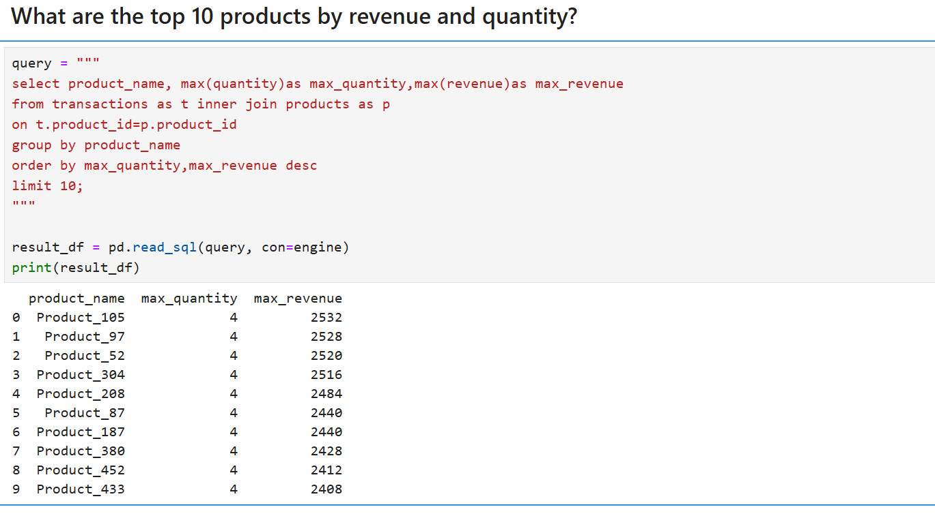

Slide 5
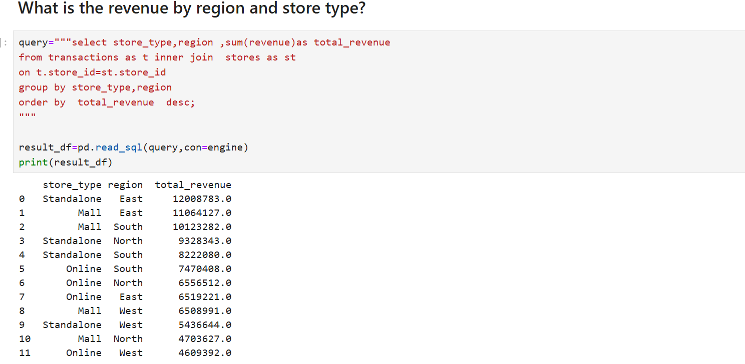

Slide 6
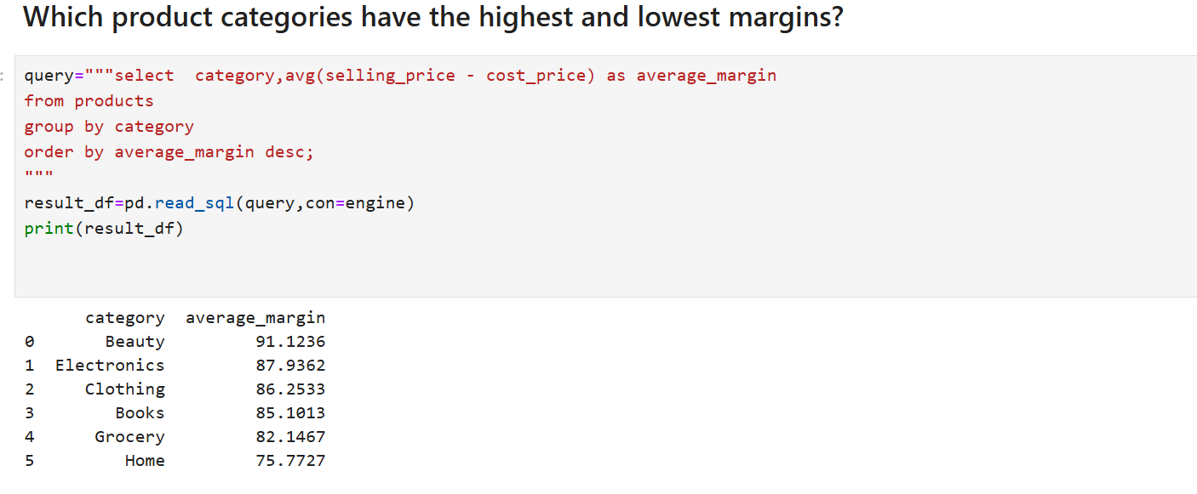

Slide 7
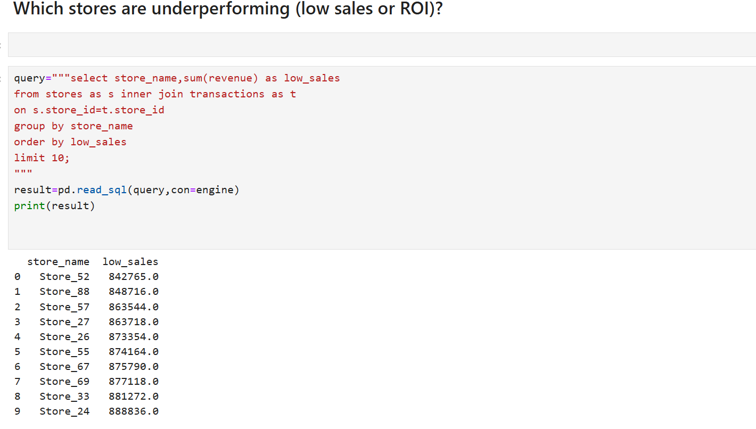

Slide 8
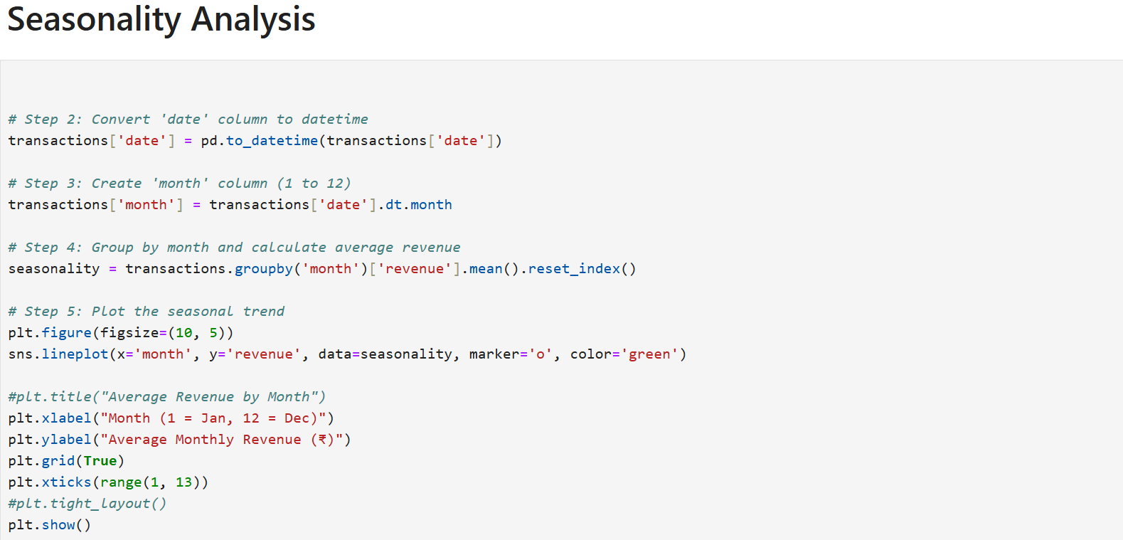
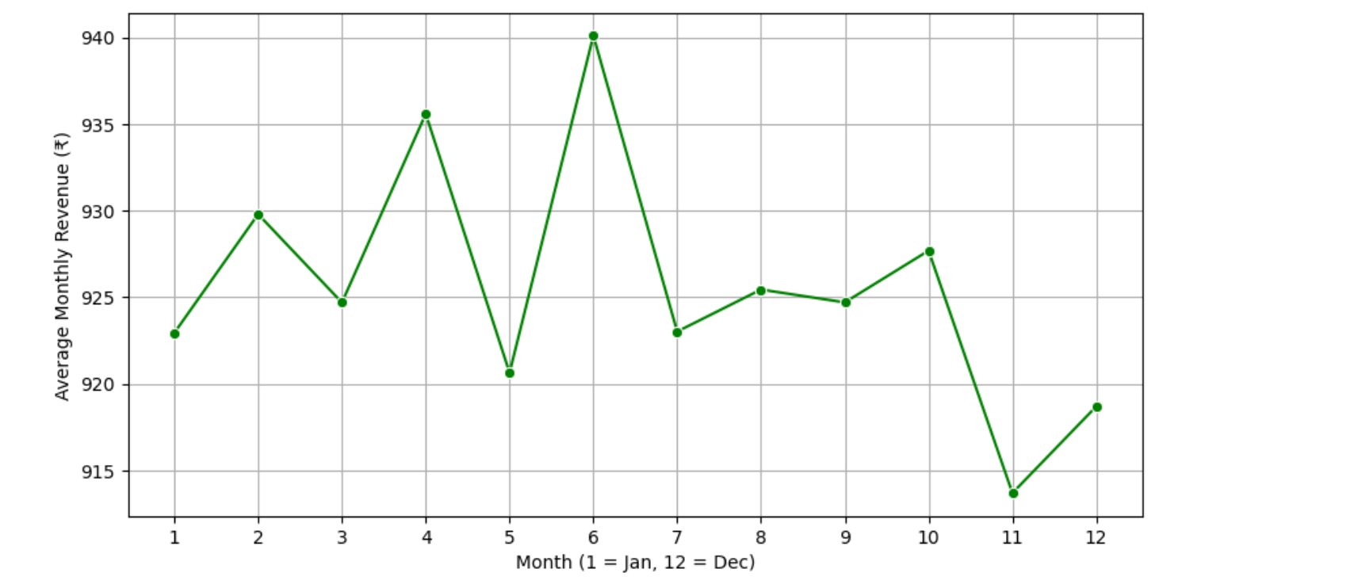

Slide 9
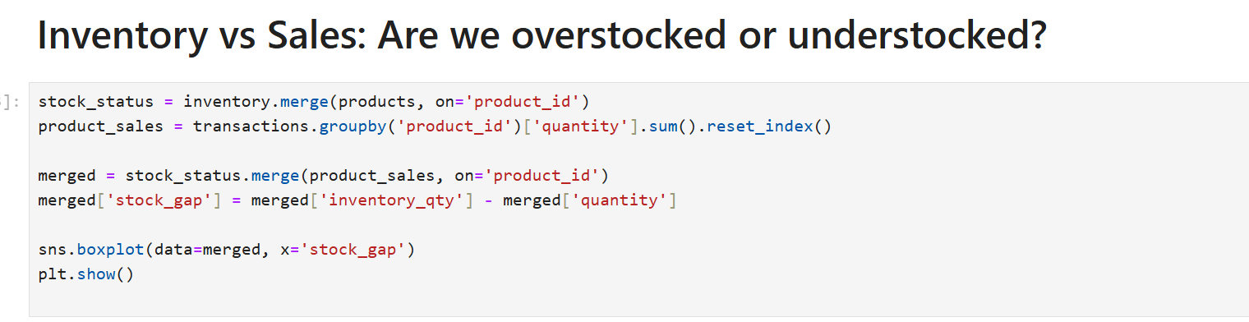
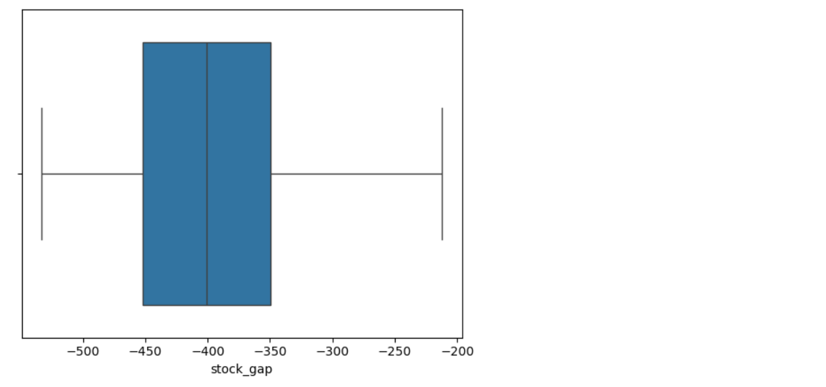

Slide 10
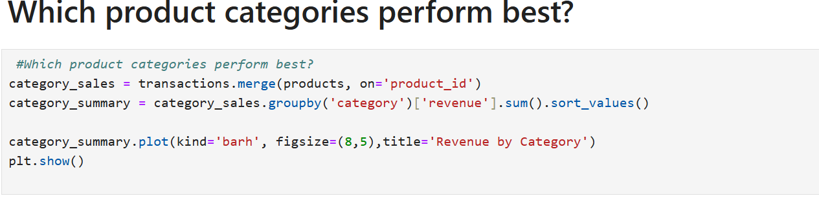
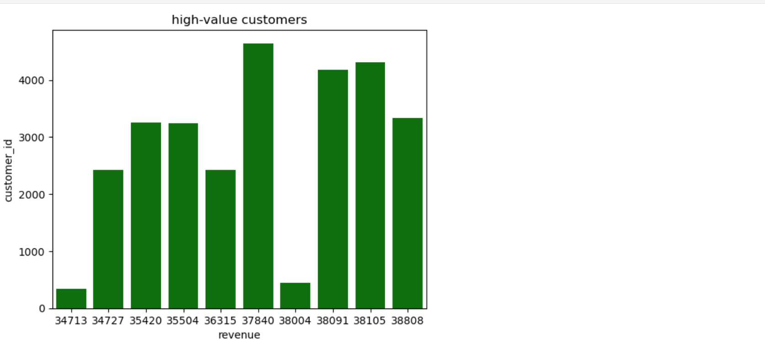

Slide 11
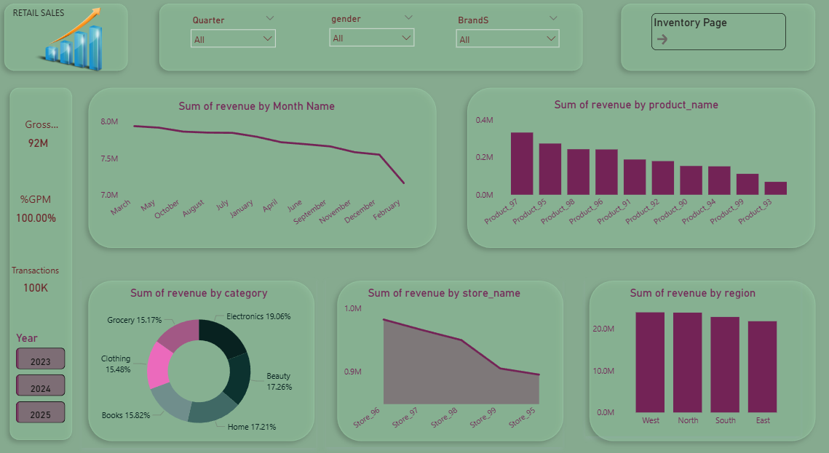

Slide 12
